Slide 1


Introduction to Python
Mark Smith

Slide 2
Course outline
Lesson 1 – Getting Started: Arithmetic Operators and Types
Lesson 2 – Variables
Lesson 3 – Functions
Lesson 4 – Conditional and Recursive Statements
Lesson 5 – Iteration
Lesson 6 – Strings
Lesson 7 – Lists
Lesson 8 – Dictionaries
Lesson 9 – Tuples
Lesson 10 – Project

Slide 3
Lesson aims
Today we will learn:
What is a program?
What is Python?
Write our first program
Use Python as a Calculator

Slide 4
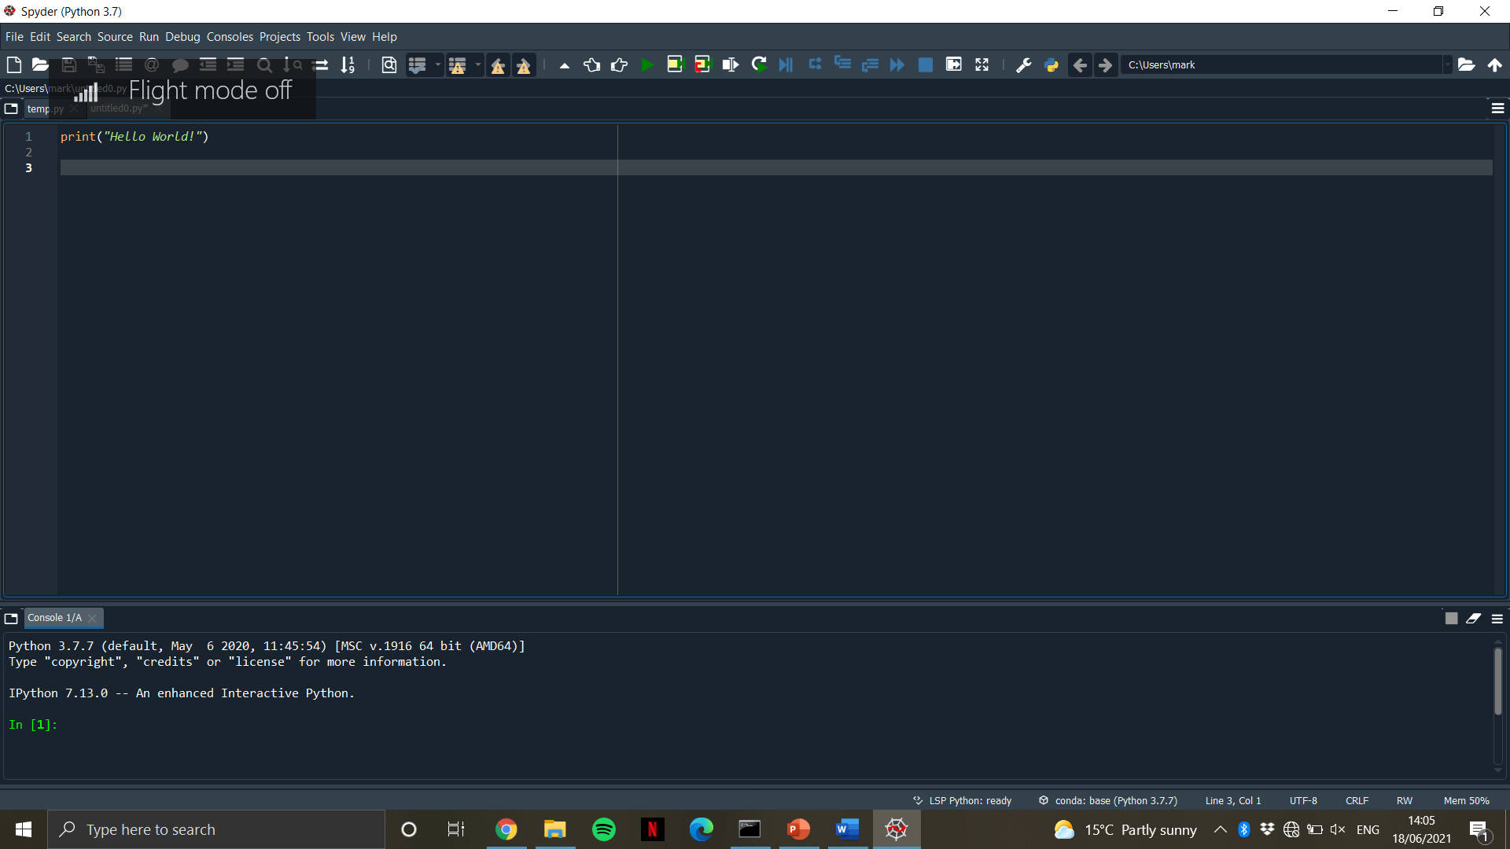
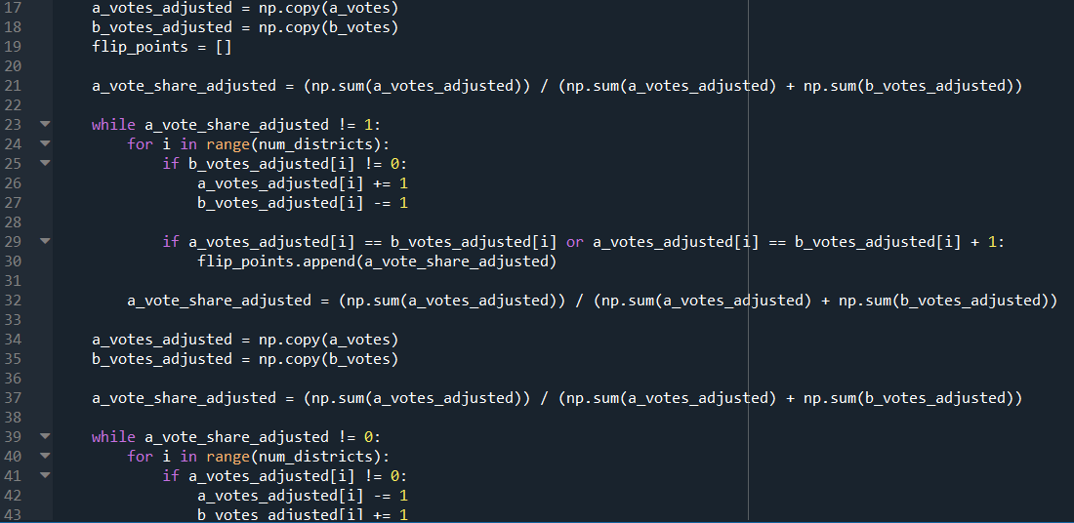
What is a program?
A set of instructions consisting of:
Input
Output
Math
Conditional Execution
Repetition

Slide 5
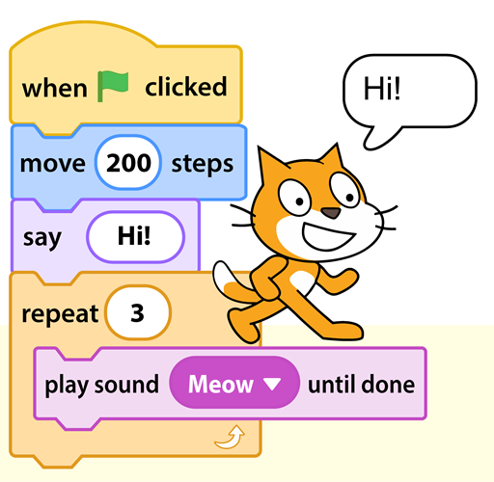

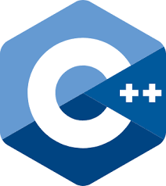
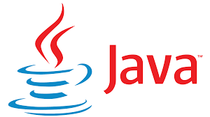
What is python?
Python is a text based Programming Language

Slide 6




What can we do with python?
Web Development
Scientific Computing
Machine Learning

Slide 7

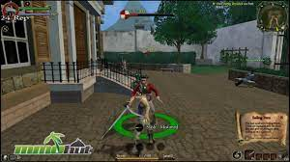

Games written in python
Disney’s Toontown Online
Pirates of the Carribbean Online
Sims 4

Slide 8
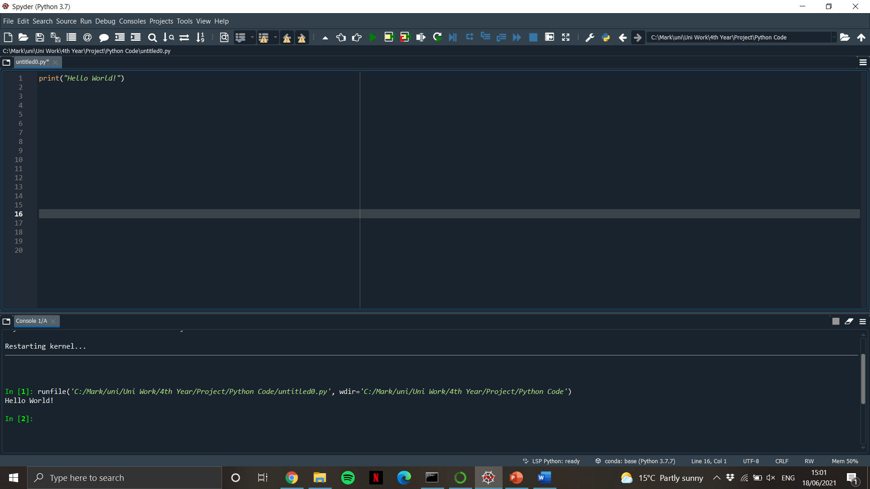

Hello world!
Let’s write our first program together!

Slide 9
arithmetic
We have the following operators in Python:
Python | Math
+ | + | Addition
- | - | Subtraction
/ | ÷ | Division
* | × | Multiplication
** | ^ | Power

Slide 10

arithmetic
Now, I will show you some examples of calculations using python
5 + 8
15 – 6
6 × 9
10 ÷ 2
$2^{5}$

Slide 11
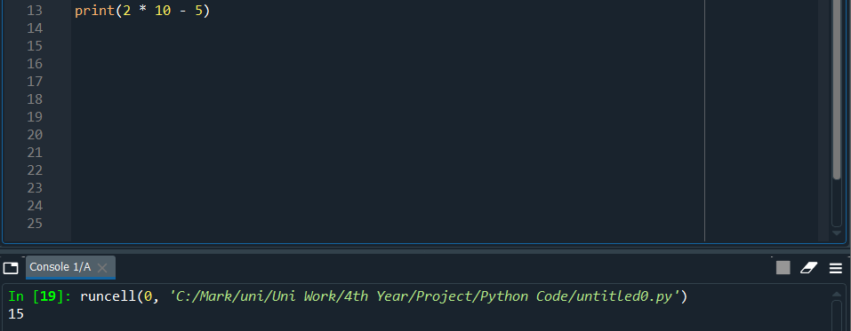
Arithmetic
We note that Python respects the order of operations:
Brackets
Indices
Division/Multiplication
Addition/Subtraction

Slide 12
Values and types
Values are the most basic components of a program
Values belong to a type
We can find the type of a value by using the command
type()

Slide 13
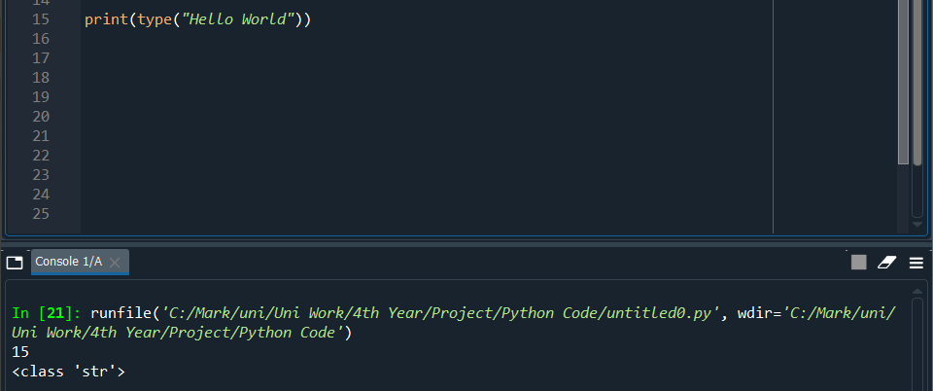
types
Code | Type
“Hello World!” | str
20 | int
20.5 | float

